Slide 1

Nanoscale and nanotechnology
Presented by- lavanya gune
(19BEC0367)

Slide 2
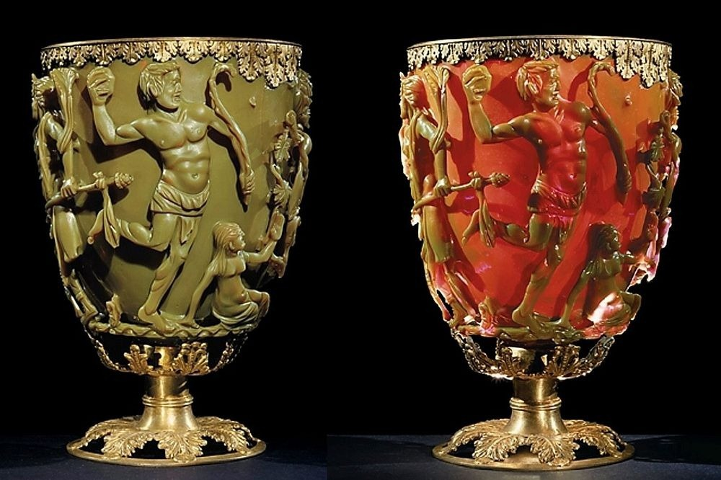
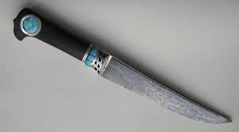
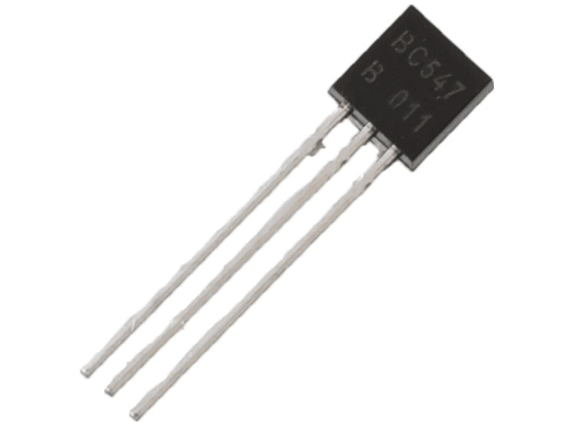
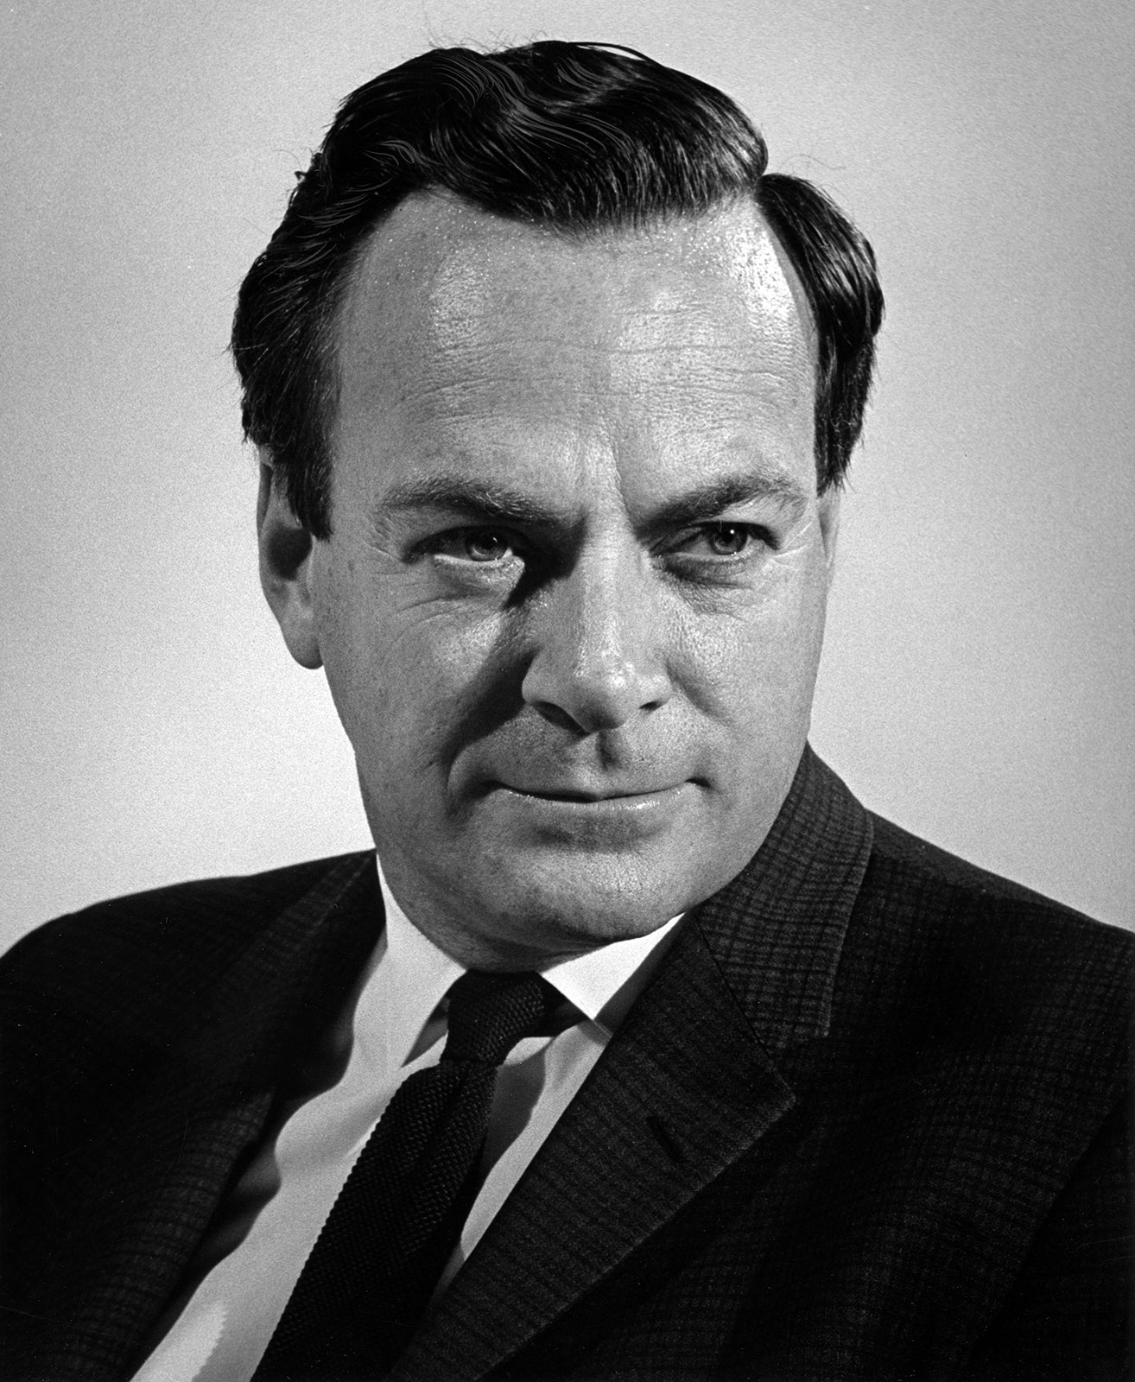
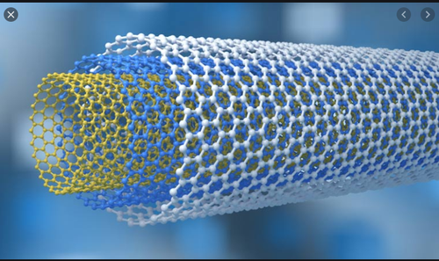
Time line of some greatest revelations in the field of nanoscience-
4th centaury
13th-18th Centuries –
1959
Richard Fayman is the scientist who was credited for predicting the potential of nano-sized particles. In 1959 he won the Nobel Prize in physics and during his speech he declared that:
1991
“Damascus” saber blades – probably one of the most famous examples of nanostructures used centuries ago. They contain carbon nanotubes and cementite nanowires
The Lycurgus Cup (Rome) represents one of the most outstanding achievements in ancient glass industry. It is probably the oldest and most famous example of dichroic glass.
1947
carbon nanotubes-It was Sumio Iijima from Japan who discovered a new form of carbon which was called carbon nanotubes, consisting of several tubes within each other.
Transistors-The discovery of the transistor by William Shockley, Walter Brattain and John Bardeen. The three men eventually won the Nobel Prize in physics for their work in 1956.

Slide 3
A flow chart of discussions in nanotechnology-
NANOTECHNOLOGY- the manipulation of materials on an atomic or molecular scale especially to build microscopic devices (such as robots) Placing atoms as though they were bricks, nanotechnology will give us complete control over the structure of matter, allowing us to build any substance or structure permitted by the laws of nature.
FUTURE APPLICATIONS – NANOBIOMATERIALS,
MICROPROCESSORS, QUANTUM COMPUTING, MOLECULAR CIRCUITARY
NANOTECHNOLOGY
IN WHICH FIELD DOES NANOSCIENCE HAS APPLICATIONS?
AEROSPACE
AGRICULTURE
MEDICINE
TRANSPORTATION
SECURITY
ROBOTICS
ENERGY
NANO BITE-
A VERY SMALL SELF PROPELLED DEVICE SPECIALLY ONE THAT HAS SOME DEGREE OF AUTONOMY AND CAN REPRODUCE

Slide 4
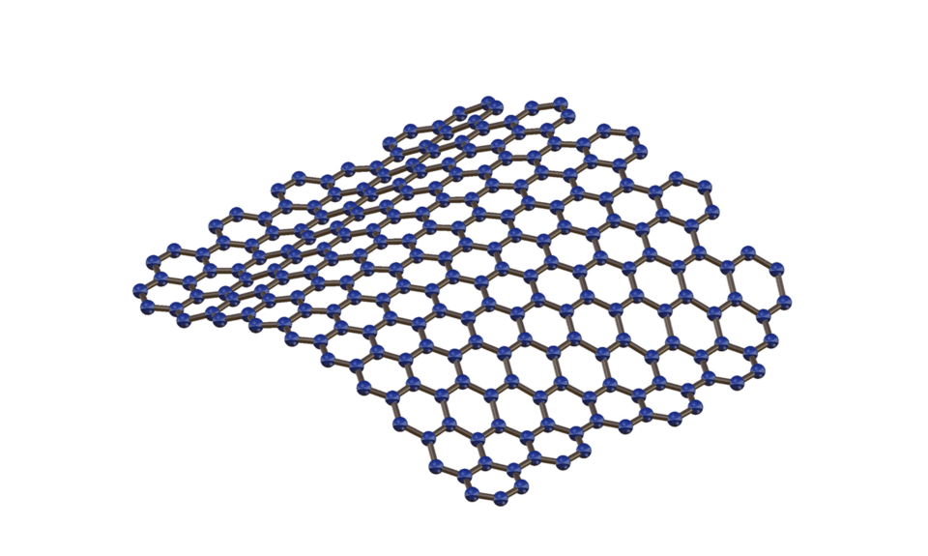
Structure of graphene-
Graphene, a honeycomb sp2 carbon lattice, seems very attractive due to its intrinsic high flexibility, electrical mobility and conductivity and become extensively used material for thin film transistors. Two dimensional atomic sheets are atomically thin, crystalline solid in layer arrangement showing interlayer Vander Waals bonding and intramolecular covalent bonding.

Slide 5

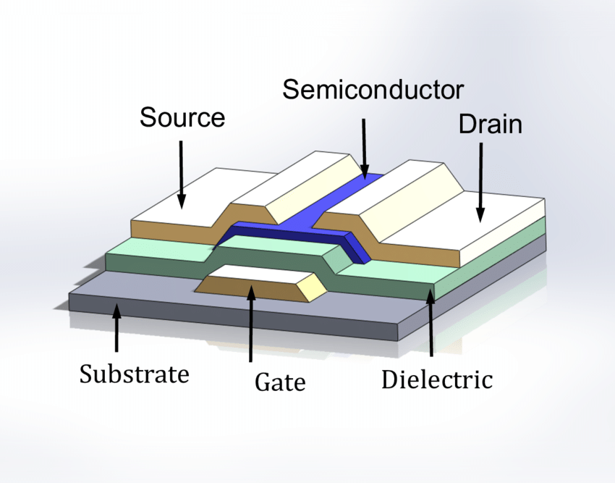
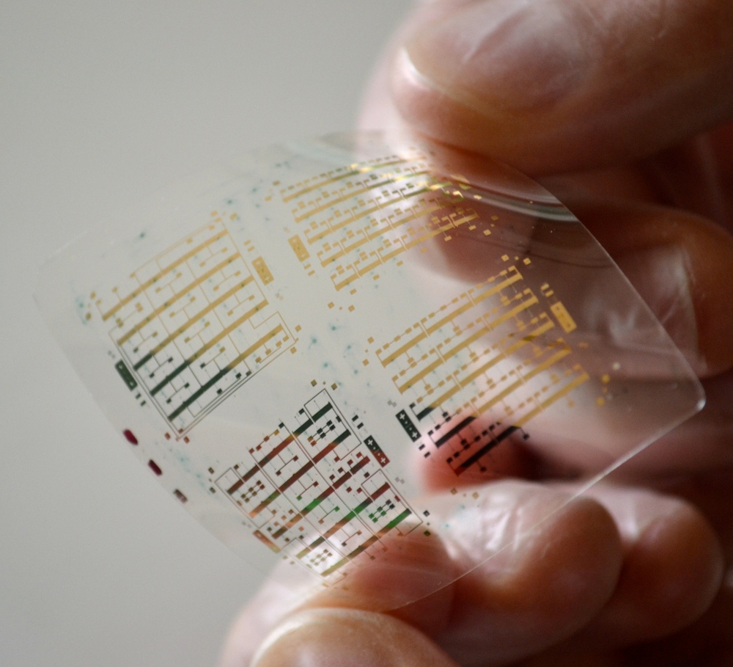
THIN FILM TRANSISTORS(TFT)

Slide 6
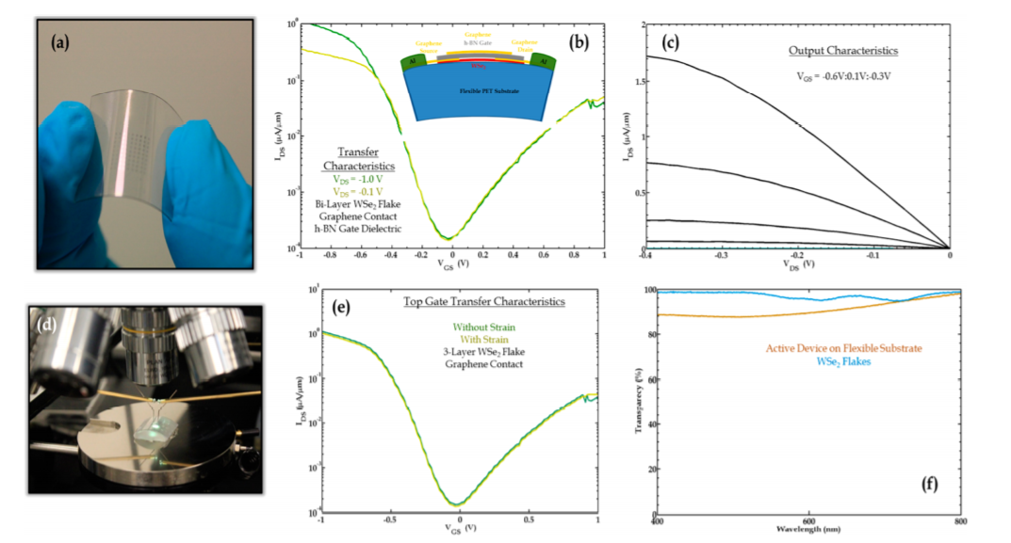
Properties of TFT due to unique structure-

Slide 7
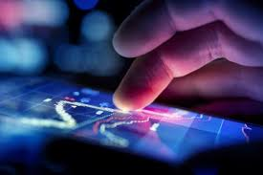
TOUCH SCREEN DISPLAY

Slide 8
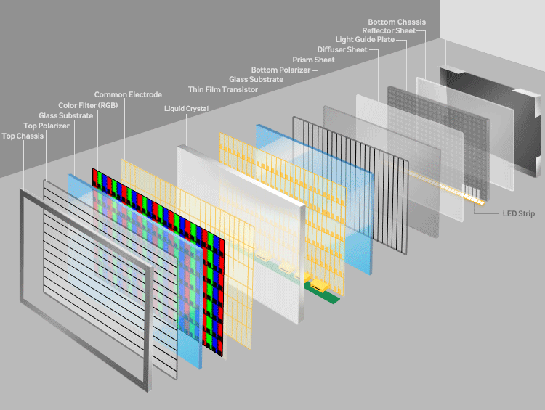
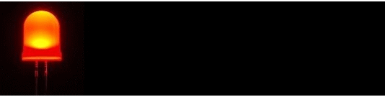
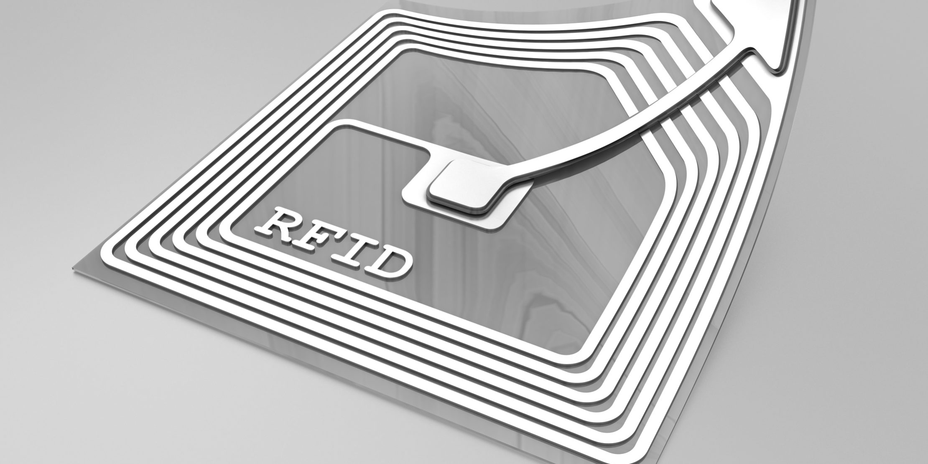
TFT FINDS ITS APPLICATIONS IN LED
WORKING OF A LCD-
THE MOST IMPORTANT APPLICATION OF A TFT LIES IN THE LCD. THE TRANSPERENCY OF THESE TRANSISTORS WERE AN ACCOLADE FOR TFT.
RFID ALSO USES TFT

Slide 9
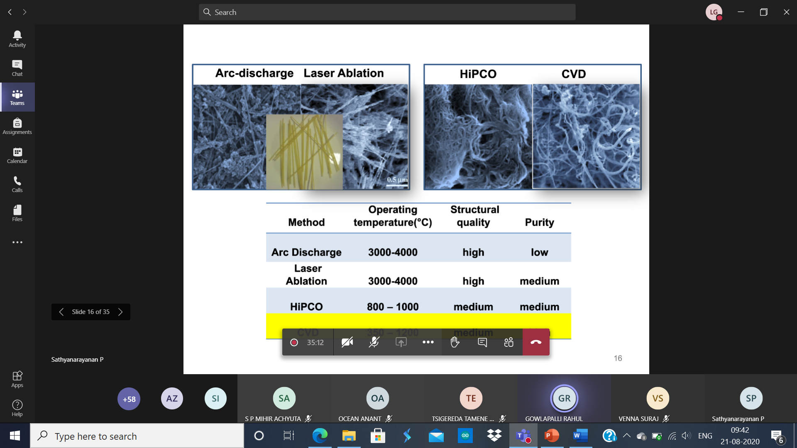
WAYS TO SYNTHESIZE GRAPHENE-

Slide 10
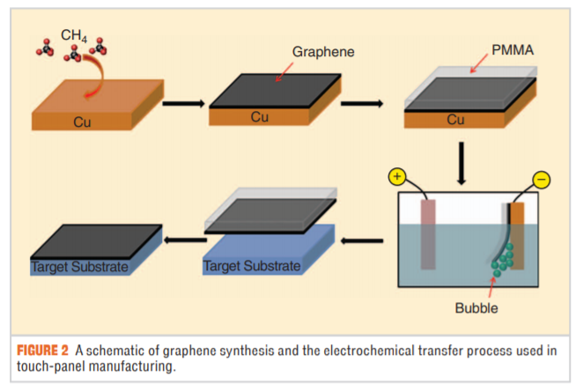
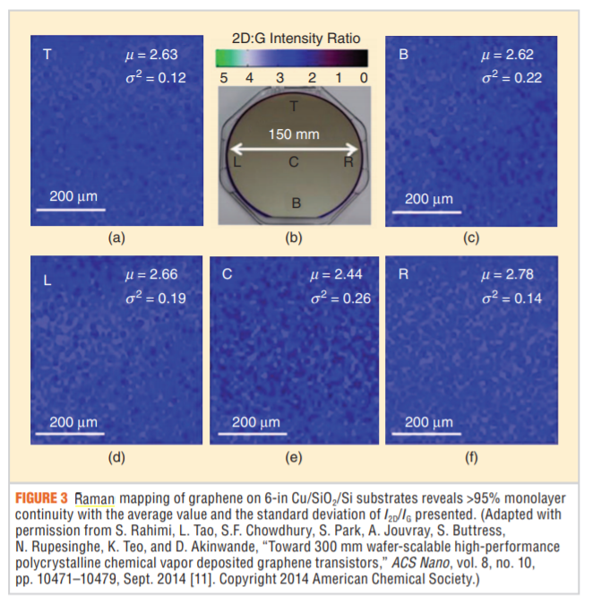
Manufacture of touch panel using graphene-

Slide 11
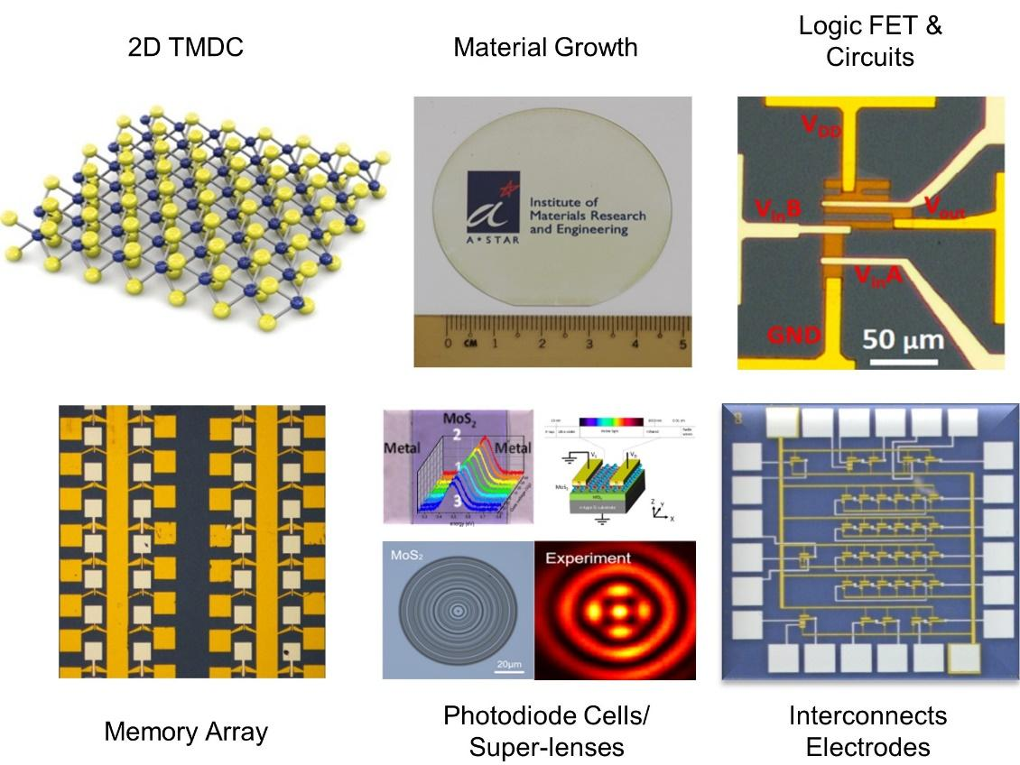
Transition metal dichalcogenides based circuits
Integrated circuits such as inverters, small signal amplifiers, logic gates, a SRAM cell, and a 5-stage ring oscillator were demonstrated using both exfoliated and CVD synthesized MoS2 samples.
The capability to directly synthesize TMDs on top of a non-conducting substrate is an important step toward system-level integration of these 2D materials. However, it is important to note that the deposition temperature is still quite high (650 °C–800 °C) and the films are polycrystalline.

Slide 12

Squid (superconducting quantum interference device)-

Slide 13
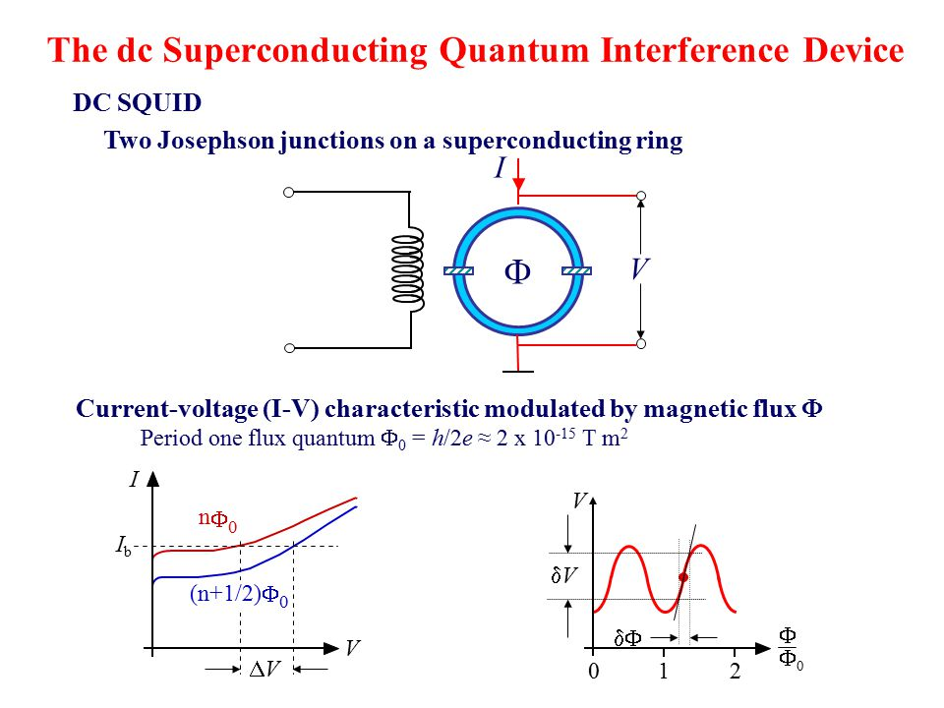
Squid (superconducting quantum interference device)-

Slide 14
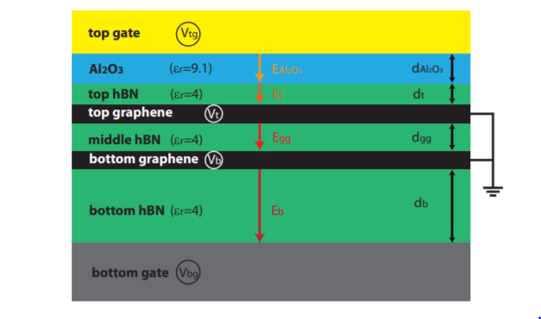
Fabrication of a : Compact SQUID realized in a double layer graphene heterostructure
Schematic side view of the DLG stack. The different layers are labelled with its dielectric constant, electric potential and thickness. The arrows define the direction of the electric fields, which was taken for the calculation.

Slide 15
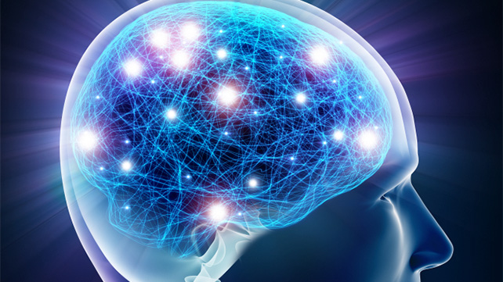
Neuromorphic nanoelectronic materials

Slide 16
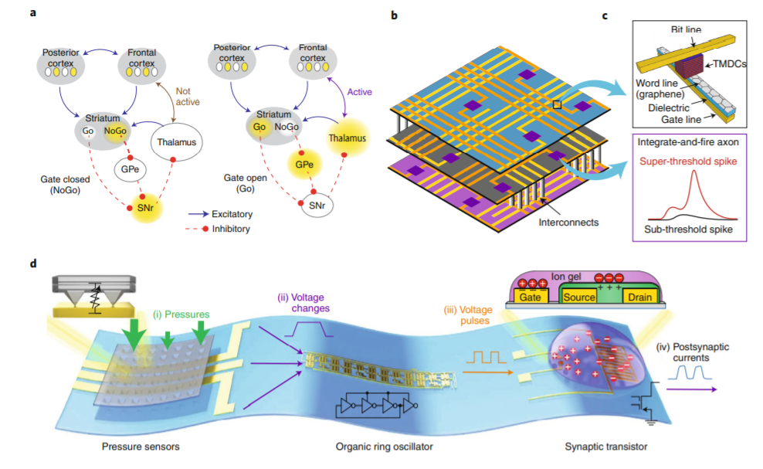
Neuromorphic nano electronic materials

Slide 17
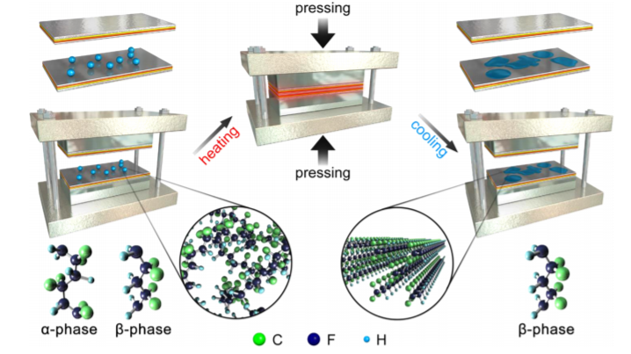
Large Piezoelectric Strain in Sub-10 Nanometer Two-Dimensional Polyvinylidene Fluoride Nanoflakes

Slide 18
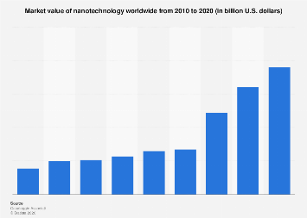
Conclusion-

Slide 19

THANKING YOU!

